Slide 1
Artificial Intelligence
Dr. Bidush Kumar Sahoo
G.I.E.T. University,
Gunupur, Odisha

Slide 2
EXPERT SYSTEMS
An expert system is a computer program that is designed to solve complex problems and to provide decision-making ability like a human expert.
It performs this by extracting knowledge from its knowledge base using the reasoning and inference rules according to the user queries.
The expert system is a part of AI, and the first ES was developed in the year 1970, which was the first successful approach of artificial intelligence.
It solves the most complex issue as an expert by extracting the knowledge stored in its knowledge base. The system helps in decision making for complex problems using both facts and heuristics like a human expert.
The Expert System in AI can resolve many issues which generally would require a human expert. It is based on knowledge acquired from an expert. Artificial Intelligence and Expert Systems are capable of expressing and reasoning about some domain of knowledge.
Expert systems were the predecessor of the current day artificial intelligence, deep learning and machine learning systems.

Slide 3
EXAMPLES OF EXPERT SYSTEMS
DENDRAL: It was an artificial intelligence project that was made as a chemical analysis expert system. It was used in organic chemistry to detect unknown organic molecules with the help of their mass spectra and knowledge base of chemistry.
MYCIN: It was one of the earliest backward chaining expert systems that was designed to find the bacteria causing infections like bacteraemia and meningitis. It was also used for the recommendation of antibiotics and the diagnosis of blood clotting diseases.
PXDES: It is an expert system that is used to determine the type and level of lung cancer. To determine the disease, it takes a picture from the upper body, which looks like the shadow. This shadow identifies the type and degree of harm.
CaDeT: The CaDet expert system is a diagnostic support system that can detect cancer at early stages.

Slide 4
CHARACTERISTICS OF EXPERT SYSTEM
High Performance: The expert system provides high performance for solving any type of complex problem of a specific domain with high efficiency and accuracy.
Understandable: It responds in a way that can be easily understandable by the user. It can take input in human language and provides the output in the same way.
Reliable: It is much reliable for generating an efficient and accurate output.
Highly responsive: ES provides the result for any complex query within a very short period of time.

Slide 5
BENEFITS OF EXPERT SYSTEMS
It improves the decision quality
Cuts the expense of consulting experts for problem-solving
It provides fast and efficient solutions to problems in a narrow area of specialization.
Offers consistent answer for the repetitive problem
Helps you to get fast and accurate answers
A proper explanation of decision making
Ability to solve complex and challenging issues

Slide 6
LIMITATIONS OF THE EXPERT SYSTEM
Unable to make a creative response in an extraordinary situation
Errors in the knowledge base can lead to wrong decision
The maintenance cost of an expert system is too expensive
Each problem is different therefore the solution from a human expert can also be different and more creative

Slide 7
APPLICATIONS OF EXPERT SYSTEMS
Information management
Hospitals and medical facilities management
Help desks management
Employee performance evaluation
Loan analysis
Virus detection
Financial decision making
Knowledge publishing
Process monitoring and control
Stock market trading
Airline scheduling & cargo schedules

Slide 8
REPRESENTING AND USING DOMAIN KNOWLEDGE
Expert system is built around a knowledge base module.
Expert system contains a formal representation of the information provided by the domain expert. This information may be in the form of problem-solving rules, procedures, or data intrinsic to the domain.
To incorporate this information into the system, it is necessary to make use of one or more knowledge representation methods. Some of these methods are described here.
Transferring knowledge from the human expert to a computer is often the most difficult part of building an expert system.
The knowledge acquired from the human expert must be encoded in such a way that it remains a faithful representation of what the expert knows, and it can be manipulated by a computer.
Three common methods of knowledge representation evolved over the years are IF-THEN rules, Semantic networks and Frames.

Slide 9
DEVELOPMENT OF EXPERT SYSTEM
Here, we will explain the working of an expert system by taking an example of MYCIN ES. Below are some steps to build an MYCIN:
Firstly, ES should be fed with expert knowledge. In the case of MYCIN, human experts specialized in the medical field of bacterial infection; provide information about the causes, symptoms, and other knowledge in that domain.
The KB of the MYCIN is updated successfully. In order to test it, the doctor provides a new problem to it. The problem is to identify the presence of the bacteria by inputting the details of a patient, including the symptoms, current condition, and medical history.
The ES will need a questionnaire to be filled by the patient to know the general information about the patient, such as gender, age, etc.
Now the system has collected all the information, so it will find the solution for the problem by applying if- then rules using the inference engine and using the facts stored within the KB.
In the end, it will provide a response to the patient by using the user interface.

Slide 10
EXPERT SYSTEM SHELLS
A new expert system can be developed by adding domain knowledge to the shell. The figure depicts generic components of expert system.

Slide 11
Knowledge acquisition system: It is the first and fundamental step. It helps to collect the experts knowledge required to solve the Problems and build the knowledge base.
Knowledge Base: This component is the heart of expert systems. It stores all factual and heuristic knowledge about the application domain. It provides with the various representation techniques for all the data.
The knowledgebase is a type of storage that stores knowledge acquired from the different experts of the particular domain. It is considered as big storage of knowledge. The more the knowledge base, the more precise will be the Expert System.
It is similar to a database that contains information and rules of a particular domain or subject.
One can also view the knowledge base as collections of objects and their attributes. Such as a Lion is an object and its attributes are it is a mammal, it is not a domestic animal, etc.

Slide 12
COMPONENTS OF KNOWLEDGE BASE
Factual Knowledge: The knowledge which is based on facts and accepted by knowledge engineers comes under factual knowledge.
Heuristic Knowledge: This knowledge is based on practice, the ability to guess, evaluation, and experiences.
Inference mechanism: Inference engine is the brain of the expert system. This component is mainly responsible for generating inference from the given knowledge from the knowledge base and produce line of reasoning in turn the result of the user's query.
It helps in deriving an error-free solution of queries asked by the user.
With the help of an inference engine, the system extracts the knowledge from the knowledge base.

Slide 13
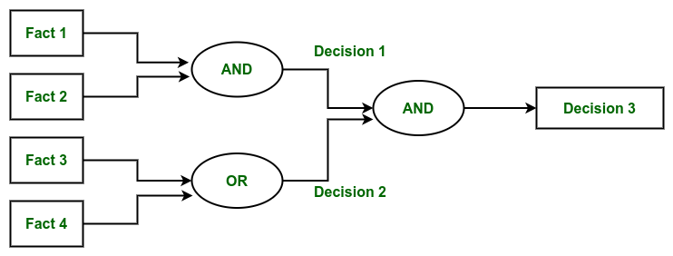
There are two types of inference engine:
Deterministic Inference engine: The conclusions drawn from this type of inference engine are assumed to be true. It is based on facts and rules.
Probabilistic Inference engine: This type of inference engine contains uncertainty in conclusions, and based on the probability.
Inference engine uses the below modes to derive the solutions:
Forward Chaining: This is a data-driven reasoning approach where the system starts with the available facts and applies rules to infer new facts or conclusions. It's typically used to predict outcomes or determine what will happen next.

Slide 14
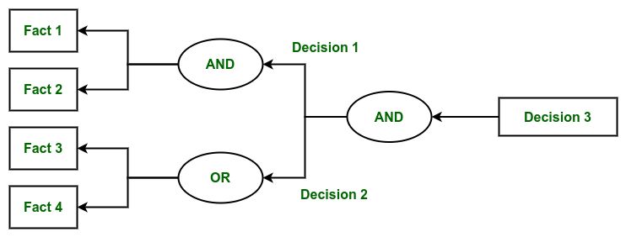
Backward Chaining: This is a goal-driven reasoning approach where the system starts with a hypothesis or a goal (something to prove) and works backward to determine which facts or conditions would support that conclusion. It's often used to diagnose issues by determining the cause of an observed effect. The examples provided include diagnosing medical conditions like stomach pain, blood cancer, or dengue.
User interface: With the help of a user interface, the expert system interacts with the user, takes queries as an input in a readable format, and passes it to the inference engine. After getting the response from the inference engine, it displays the output to the user.
In other words, it is an interface that helps a non-expert user to communicate with the expert system to find a solution.
Building expert systems by using shells has significant advantages.
It is always advisable to use shell to develop expert system as it avoids building the system from scratch.
To build an expert system using system shell, one needs to enter all necessary knowledge about a task domain into the shell.

Slide 15
EXPLANATION Subsystem
In order for an expert system to be an effective tool, people must be able to interact with it easily. To facilitate this interaction, the expert system must have the following two capabilities in addition to the ability to perform its underlying task:
Explain its reasoning: In many of the domains in which expert systems operate, people will not accept results unless they have been convinced of the accuracy of the reasoning process that produced those results.
This is particularly true, for example, in medicine, where a doctor must accept ultimate responsibility for a diagnosis, even if that diagnosis was arrived at with considerable help from a program.
Thus it is important that the reasoning process used in such programs proceed in understandable steps and that enough meta-knowledge (knowledge about the reasoning process) be available so the explanations of those steps can be generated.
Acquire new knowledge and modifications of old knowledge: Since expert systems derive their power from the richness of the knowledge bases they exploit, it is extremely important that those knowledge bases be as complete and as accurate as possible.
But often there exists no standard codification of that knowledge; rather it exists only inside the heads of human experts. One way to get this knowledge into a program is through interaction with the human expert. Another way is to have the program learn expert behavior from raw data.

Slide 16
KNOWLEDGE ACQUISITION
Knowledge acquisition is the process of extracting, structuring and organizing knowledge from one source, usually human experts, so it can be used in software such as an ES. This is often the major obstacle in building an ES.
There are three main topic areas central to knowledge acquisition that requires consideration in all ES projects. First, the domain must be evaluated to determine if the type of knowledge in the domain is suitable for an ES.
Second, the source of expertise must be identified and evaluated to ensure that the specific level of knowledge required by the project is provided.
Third, if the major source of expertise is a person, the specific knowledge acquisition techniques and participants need to be identified.
Knowledge acquisition is the gathering or collecting knowledge from various sources. It is the process of adding new knowledge to a knowledge base and refining or improving knowledge that was previously acquired.
Acquisition is the process of expanding the capabilities of a system or improving its performance at some specified task. So it is the goal oriented creation and refinement of knowledge.

Slide 17
Acquired knowledge may consist of facts, rules, concepts, procedures, heuristics, formulas, relationships, statistics or any other useful information.
Source of these knowledges may be experts in the domain of interest, text books, technical papers, database reports, journals and the environments. The knowledge acquisition is a continuous process and is spread over entire lifetime.
Example of knowledge acquisition is machine learning. It may be process of autonomous knowledge creation or refinements through the use of computer programs.
The newly acquired knowledge should be integrated with existing knowledge in some meaningful way. The knowledge should be accurate, non-redundant, consistent and fairly complete.
Knowledge acquisition supports the activities like entering the knowledge and maintaining knowledge base. The knowledge acquisition process also sets dynamic data structures for existing knowledge to refine the knowledge.

Slide 18
KNOWLEDGE ACQUISITION TECHNIQUES
Many techniques have been developed to deduce knowledge from an expert. They are termed as knowledge acquisition techniques. They are:
Diagram Based Techniques
Matrix Based Techniques
Hierarchy-Generation Techniques
d) Protocol Analysis Techniques
e) Protocol Generation Techniques
In diagram based techniques the generation and use of concept maps, event diagrams and process maps. This technique captures the features like “why, whe n, who, how and where”.
The matrix based techniques involve the construction of grids indicating such things as problems encountered against possible solutions. Hierarchical techniques are used to build hierarchical structures like trees. Protocol analysis technique is used to identify the type of knowledge like goals, decisions, relationships etc. The protocol generation techniques include various types of interviews like structured, semi-structured and unstructured.

Slide 19
HOW THESE COMPONENTS WORK TOGETHER?
Imagine a medical expert system designed to diagnose diseases:
Input: A patient reports symptoms like fever, cough, and fatigue through the user interface.
Processing: The inference engine analyzes the symptoms using rules from the knowledge base.
Output: The system suggests a possible diagnosis, such as pneumonia.
Explanation: The explanation module provides a detailed explanation, such as "The diagnosis is based on the presence of fever, cough, and abnormal chest X-ray results."
Update: The knowledge acquisition module adds new data, such as recent research on pneumonia treatments, to keep the system up-to-date.

Slide 20
TYPES OF EXPERT SYSTEMS IN AI
Depending on their structure and application, expert systems can be categorized into different types.
1. Rule-Based Expert Systems
One of the most common types is Rule-Based Expert Systems, which rely on if-then rules to process information and make decisions. These rules are typically crafted by domain experts and serve as the system’s reasoning mechanism. A well-known example is MYCIN, an early medical diagnosis system that identified bacterial infections.
2. Frame-Based Expert Systems
Another category is Frame-Based Expert Systems, which organise knowledge using frames, similar to objects in programming. These frames store attributes and values related to specific concepts, making them useful in natural language processing and other knowledge representation tasks.

Slide 21
3. Fuzzy Logic Systems
For situations involving uncertainty and imprecision, fuzzy logic Systems come into play. These systems don’t operate on strict true/false values but instead allow for degrees of truth. Fuzzy control systems, commonly used in household appliances like washing machines and air conditioners, leverage this approach to optimize performance based on variable input conditions.
4. Neural Network-Based Expert Systems
Integrate artificial neural networks to learn patterns from data and improve decision-making. These systems are widely used in applications like image recognition and speech processing, where traditional rule-based approaches might struggle.
5. Neuro-Fuzzy Expert Systems
A more advanced hybrid approach is Neuro-Fuzzy Expert Systems, which merge the learning capabilities of neural networks with the uncertainty-handling strengths of fuzzy logic. These systems are particularly useful in financial forecasting and automated control systems, where both structured learning and flexible reasoning are necessary.

Slide 22
THANK YOU

